Slide 1
Immune Response against Helminthes
Dr Mohammed Shoeb
Assistant Professor
Department of Zoology
Govt. Dr WW Patankar Girl’s PG College, Durg

Slide 2
Introduction
Helminthes are large, multicellular organisms that reside in humans but do not ordinarily multiply there and are not intracellular pathogens.
Although helminthes are more accessible to the immune system than protozoans, most infected individuals carry few of these parasites; for this reason, the immune system is not strongly engaged and the level of immunity generated to helminthes is often very poor.

Slide 3
Helminth species | Disease or condition in humans | Estimate prevalence worldwide | Habitat of adult worm in humans
Nematodes
Ascaris lumbricoides | Ascariasis | 804 million | Small intestine
Trichuris trichiura | Trichuriasis | 477 million | Large intestine
Enterobius vermicularis | Enterobiasis (Oxyuriasis) | >200 million
Ancylostoma duodenale | Ancylostomiasis
Wuchereria bancrofti | Lymphatic filariasis | 44 million | Lymphatic vessels
Trichinella spiralis | Trichinellosis | 0.066 million | Small intestine
Trematodes
Schistosoma mansoni | Intestinal schistosomiasis | 206 million | Mesenteric veins
Schistosoma haematobium | Urogenital schistosomiasis |  | Venous plexus of urinary bladder
Fasciola hepatica | Fascioliasis | 80 million | Bile ducts
Cestodes
Echinococcus granulosus | Hydatid disease | 0.8 million | N/A
Cysticercus cellulosae ( Taenia solium larva) | Cysticercosis and Neurocysticercosis | 1 million | N/A
Taenia solium | Intestinal taeniasis | 0.38 million | Small intestine

Slide 4
Immune Response
The immune response to helminths involves a range of innate and adaptive pathways that work together to expel and resist the parasites:
Type 2 immune response
This response is characterized by the accumulation of cells such as eosinophils, basophils, mast cells, and CD4+T helper 2 (TH2) cells. These cells produce cytokines that change the epithelial cells to clear the parasite.
Antibody-dependent cellular cytotoxicity (ADCC)
This process involves the use of antibodies like IgE, IgG, or IgA to cover parasitic structures. Cells with receptors for the Fc fragment (RFc) then destroy the parasitic structures.

Slide 5
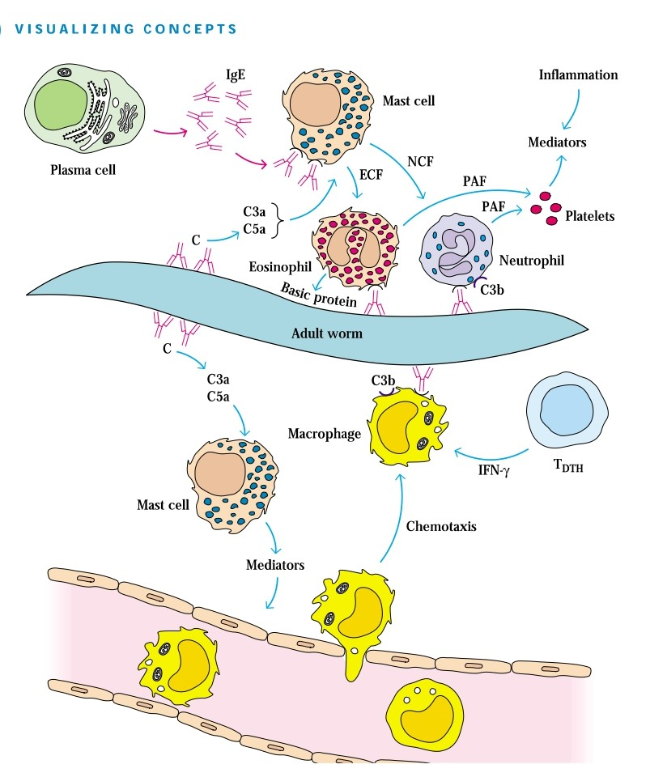

Slide 6
Overview of the immune response generated against Schistosoma mansoni
The response includes an IgE humoral component (top)
The cell-mediated component involving CD4+ T cells (bottom).
C = complement; ECF = eosinophil chemotactic factor; NCF = neutrophil chemotactic factor; PAF = platelet-activating factor

Slide 7
References
Helminth parasites and immune regulation
Pedro H Gazzinelli-Guimaraes, Thomas B Nutman
Immunity against Helminths: Interactions with the Host and the Intercurrent Infections
Emmanuelle Moreau, Alain Chauvin
Immunology by Kuby

